Slide 1
Housing Elements 101
East Bay Housing Organizations
February 29, 2024

Slide 2
Introduction
Presenters
Jeff Levin, Sr. Director of Policy
Aaron Tiedemann, Policy Manager
Lindsay Haddix, Executive Director
Please put questions in the chat, and we will answer them after presentation!

Slide 3
Overview
Introduction to housing elements
Findings from the 6th cycle
How to get involved
Q & A
Take action!

Slide 4
Introduction to
Housing Elements

Slide 5
What is a Housing Element?
A Housing Element is how local jurisdictions plan to meet the housing needs of everyone in the community
Part of the jurisdiction’s General Plan
Updated every eight years and subject to extensive state requirements and review
Requires cities to plan, doesn’t require building

Slide 6
Determining Housing Needs
State provides regional housing needs projection (RHND)
Regional council of governments assigns share of regional needs to each jurisdiction (RHNA)
Needs are broken down by income level
RHNA increased significantly from 5th Cycle to 6th Cycle

Slide 7
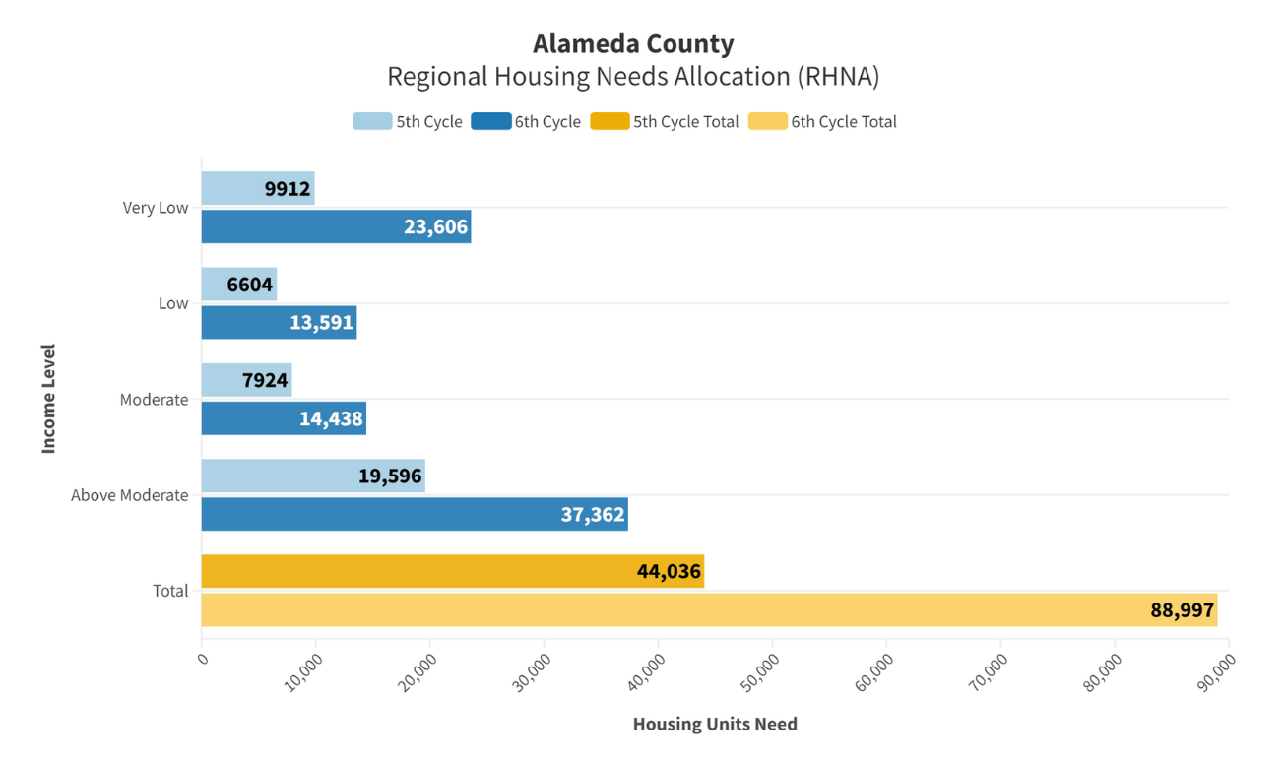

Slide 8
Housing Element Process
Locality prepares draft Housing Element
⇩
State HCD reviews and comments
⇩
Locality revises and adopts
⇩
HCD reviews and approves (or requires further changes)
⇩
Annual reporting requirements

Slide 9
Major Components
Public Participation
Assessment of Past Performance
Needs Assessment
Must include Fair Housing Assessment

Slide 10
Major Components (cont’d)
Analysis of Constraints
Site Inventory
Action Program

Slide 11
New Laws Shaped This Cycle
Affirmatively Furthering Fair Housing (AFFH)
Stricter requirements for adequate sites
“No Net Loss” rule
“Builder’s Remedy”
New housing compliance unit at the State

Slide 12
Findings From
the Sixth Cycle

Slide 13
Read EBHO’s
latest report:
bit.ly/he-report

Slide 14
Key Findings
Housing Elements were held to higher targets and stricter standards.
AFFH has proved to be a powerful tool for advancing housing justice.
Local governments were unprepared and under-resourced for the expanded scope of work.
Despite new consequences, some jurisdictions fought state mandates.

Slide 15
Key Finding #1: In the Sixth Cycle, Housing Elements were held to higher targets and stricter standards.
Regional Housing Needs Allocations more than doubled
Hyper-specific language was needed to fulfill high standards
Everything needed a clear plan and a timeline
Rejections were common, and long

Slide 16
Key Finding #2: California’s AFFH rule has proved to be a powerful tool for advancing housing justice.
Exclusionary communities were firmly on the chopping block
NIMBYs were still loud, but not could not take up all the oxygen
Wiggle room and flawed tools means we still have room to improve

Slide 17
Key Finding #3: Local governments were unprepared and under-resourced for the expanded scope of work.
Many jurisdictions didn’t start until the last minute
Local elected officials were poorly prepared to approach the biggest decisions
The State struggled to provide enough staff time and feedback

Slide 18
Key Finding #4: Despite new consequences, some jurisdictions fought state mandates.
Many chose to fight the State rather than get down to work
The Builder’s Remedy and Lawsuits helped dissuade some of these naysayers
New enforcement means fewer may slip through the cracks this time around

Slide 19
Policy Recommendations
Provide more funding for HCD and technical assistance for governments at every level.
Emphasize Affirmatively Furthering Fair Housing as a central piece of any Housing Element.
Fund affordable housing development.

Slide 20
Get Involved

Slide 21
Two ways to take action:
Hold your city, town, or county accountable for implementing the plan in their Housing Element
Support the campaign for a $10-20 billion regional bond to help us meet our affordable housing goals

Slide 22
Hold your city accountable
Jurisdictions release Annual Progress Reports (APRs) to share their progress towards meeting RHNA goals
Data on housing development applications, entitlements, building permits, and completions
Public hearings and chance for comment
Stay tuned for more information when this cycle’s first APRs are released in April!

Slide 23
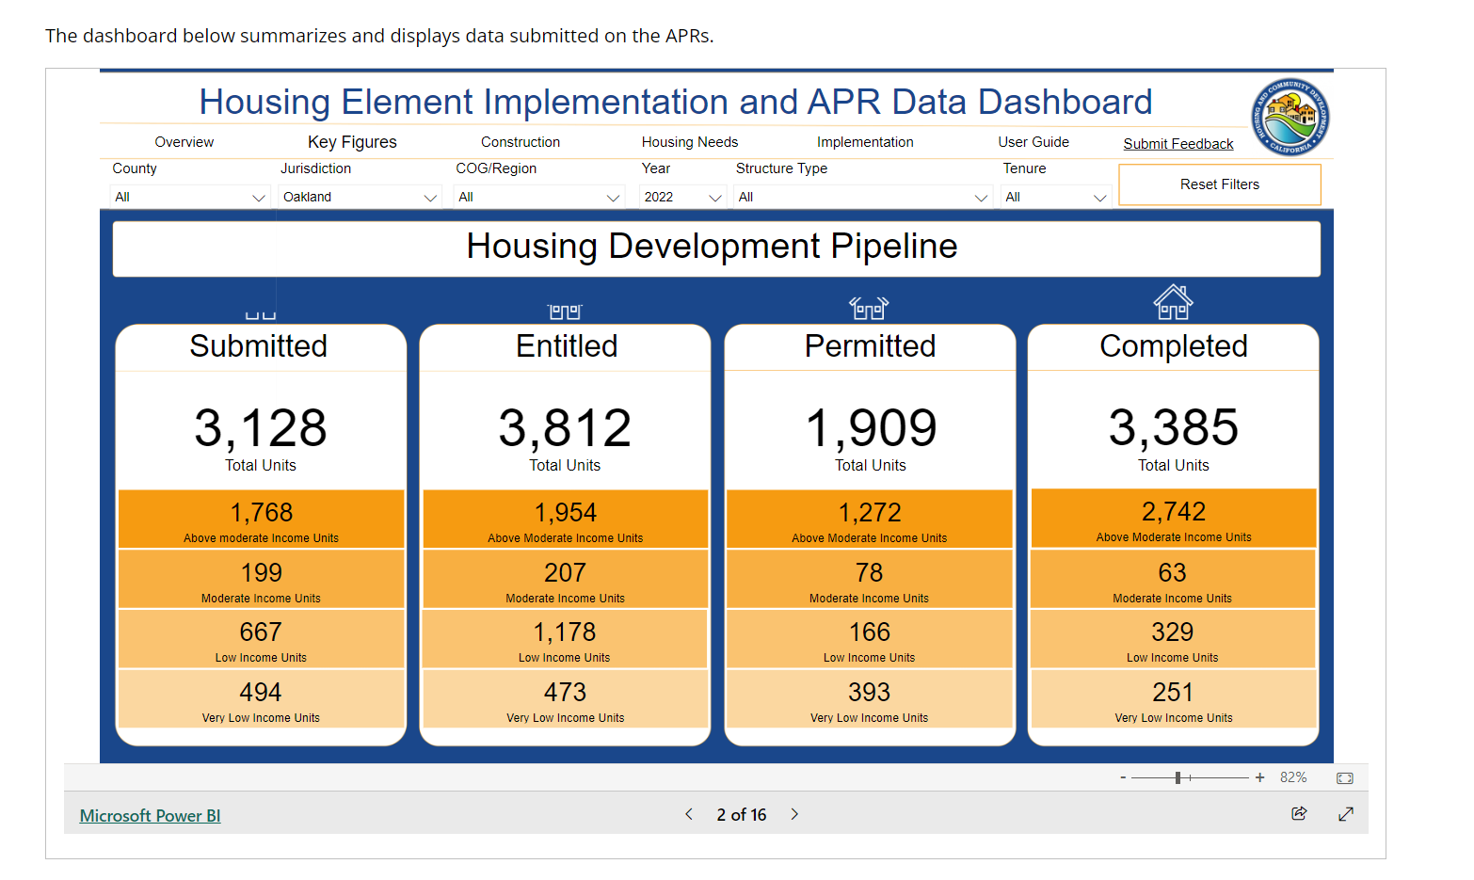
APR Example - Oakland 2022

Slide 24
Win billions at the ballot box
Problem: We need more $$ to meet our affordable housing RHNA goals.
Solution: The Bay Area Housing Finance Authority (BAHFA) is poised to place a $10-20B nine-county regional housing bond measure on the November 2024 ballot!

Slide 25
What is BAHFA?
Established in 2019 by state law
Works together with the Metropolitan Transportation Commission (MTC) and Association of Bay Area Governments (ABAG)
Focused on regional affordable housing solutions:
Produce new affordable housing
Preserve existing housing affordable to low- and middle-income households
Protect tenants at risk for displacement
Notes:
BAHFA – the first regional housing finance authority in the state – may place a $10-$20 billion affordable housing bond measure on the November 2024 ballot to benefit the nine-county Bay Area. This money would be used to build affordable homes and help keep existing housing affordable in every county.
A $20 billion bond could create 80,000 new affordable homes — over two times more than what would be possible without a bond. Read the resources about the proposal below.

Slide 26
Massive Impact
A $10 billion bond would:
Produce and preserve upwards of 45,000 affordable homes
Unlock $38.1 billion for affordable housing from other funding sources
House 500,000 low-income households over the lifetime of these developments
A $20 billion bond would double that impact!

Slide 27
Q&A

Slide 28
Take Action!
Go to bayareahousingforall.org
Enter your information to endorse the multibillion-dollar housing bond
Do you represent an organization that would like to endorse the bond? Would you like a presentation about the bond?
Please email angelina@ebho.org

Slide 29
Take Action! Right Now!
Click on Supporters, and look for your mayor’s name
If your mayor’s name is on the list, send them a thank you message
If they are not on the list, ask them to please endorse the bond
Sample emails are available at bit.ly/regional-bond-action
Notes:
Click on Supporters — this is a list of elected officials who have officially supported the bond. Look for your mayor’s name on the list. If your mayor’s name is on the list, send them a thank you message. If they are not on the list, send them an email asking them to endorse.
To make things easier for you, we have a list of your mayors’ email addresses and sample emails ready to go at bit.ly/ebho-take-action. If you need help figuring out who your email is, please ask for help in the chat!

Slide 30
Thank you!
Join us on Thursday, March 28th at 1 PM for a Member Orientation!
https://ebho.org/membership/

