Slide 1
Affordable Housing Week
May 2021
Notes:
My name is Pam Glassoff
I have worked as a housing specialist for 22 years promoting housing programs and educating landlords on how they can participate and still protect their bottom line. Currently, I work for 2-1-1 Alameda County as Housing Coordinator and maintain the housing database of 75,000 units.

Slide 2
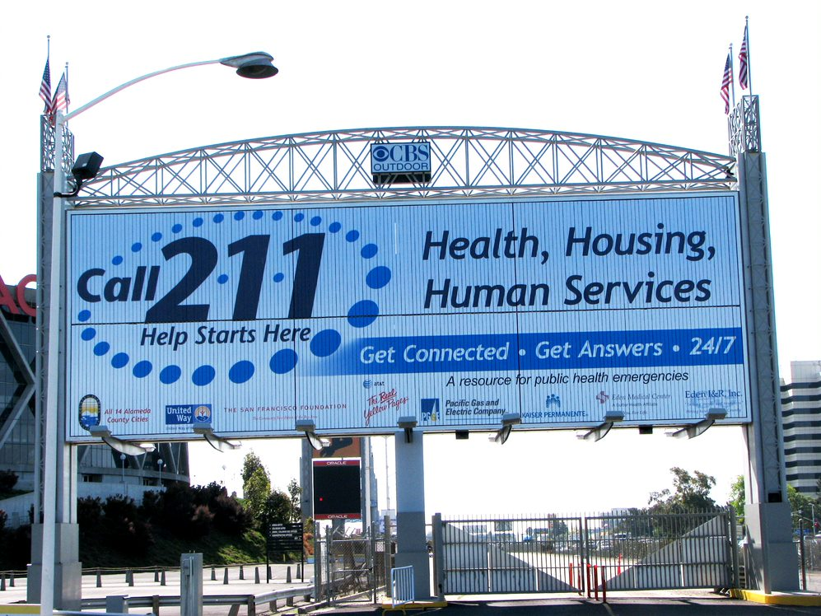
Notes:
How many of you have heard or know of 2-1-1?
How many have used or know someone who have used 2-1-1?
Today I will be sharing with you information about 211 and how it provides advertising and exposure to those with housing vouchers and programs who are in the market for a rental.

Slide 3
Mission: Connect people to resources. Vision: We envision a community empowered with information and connected to resources so that all people obtain health, happiness, hope, and improved livelihoods.
Notes:
Our goal is to connect people and resources. It is known by two names, Eden I&R. The Eden I&R was founded in 1976 and since then has had over 42 years of experience serving the public by providing information to services and housing.
It has a multicultural and multilingual staff who are trained on how to a assess the needs of the caller and then provide the appropriate referrals from the human services and housing databases.

Slide 4
2-1-1 DURING TIMES OF DISASTER
Notes:
Besides providing I&R on health, housing, and human services on a daily basis. During and after a disaster such as a major earthquake, landslide, fire, etc., the public can call 2-1-1 to get information about road closures, temporarily shelters and food, medical services, how to help, etc.. 2-1-1 took overflow calls from Carr Fire, Hurricane Florence and Hurricane Harvey. calls from

Slide 5
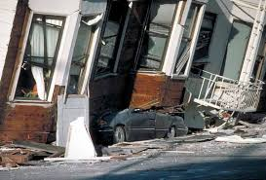
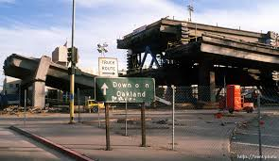
Loma Prieta Earthquake 1989

Slide 6
- Approved by the CPUC to be the 2-1-1 operator for Alameda County in 2003 - 2-1-1 launched officially on July 1, 2007
Notes:
CPUC = “California Public Utilities Commission”.
Launched officially in California / Alameda County in 2007, but note that 2-1-1 is national.

Slide 7
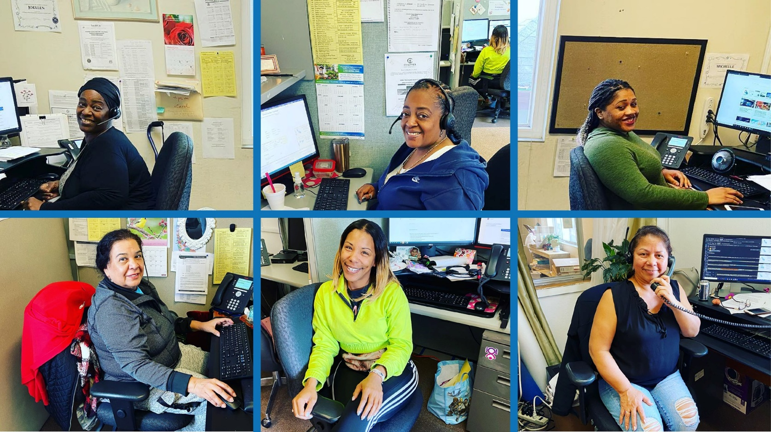
211 Alameda County
Launched officially on July 1, 2007

Slide 8
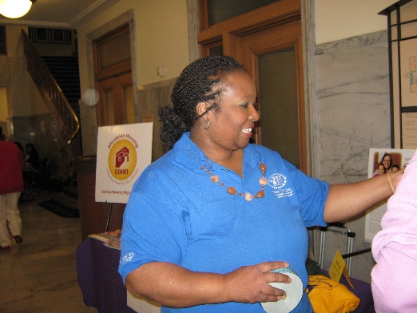
Ollie Arnold Housing Department
Over 75,000 units
Covers Alameda County and Adjoining Counties
Includes many property details
Free Service
Updated daily

Slide 9
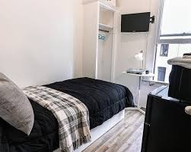
What do we list in our housing database?
Market Rate Housing
Shared Housing
Affordable Housing

Slide 10
Housing Data Quality
Affordable housing is updated monthly
We strive to capture all affordable housing in Alameda County.
Over 200 waiting lists open in Alameda County
Check monthly for new open lists.
Shares updated monthly
510-727-9565, www.achousingchoices.org
housing@edenir.org
Notes:
We are the only 2-1-1 in the state that has a housing database. Our staff answers calls during business hours and maintains housing records for 75,000 units. The database contains affordable housing with wait lists and affordable vacancies and properties that accept housing vouchers.

Slide 11
Landlord Testimonials
Almira has always been a really wonderful person to work with. She has always helped me out in the past. 211 has sent a referral for a good tenant that has been with me for 5 years. I will always call Eden I & R housing referral whenever there is a vacancy because they have always given me excellent service. I look forward to working with Eden in the future.“
"Landlord Testimonial on 5/11/2021"
Landlord, Mel Burton’s Audio
Notes:
Testimonials

Slide 12
HOW TO LIST A PROPERTY WITH 2-1-1
Fill out the form on our website
Call us at
(510) 727-9565
www.achousingchoices.org. Scroll to the bottom and click on “List Your Property”
Agency Website
www.edenir.org
E-mail us at
housinginfo@edenir.org
Notes:
Ways to list your property with 2-1-1. Use our website and

Slide 13
Case Management programs, AHIP program
Call
510-537-2600
Toll free
877-424-3746

Slide 15
Housing Related Services
Deposit assistance
Back rent assistance
Financial assistance on utility bills
Legal aid
Furniture
Transitional Housing
Coordinated Entry System
Helps people stay in housing and get back into housing.
Notes:
Your tenants can call 2-1-1- and get referrals to services that will help them remain stable through tough times.

Slide 16
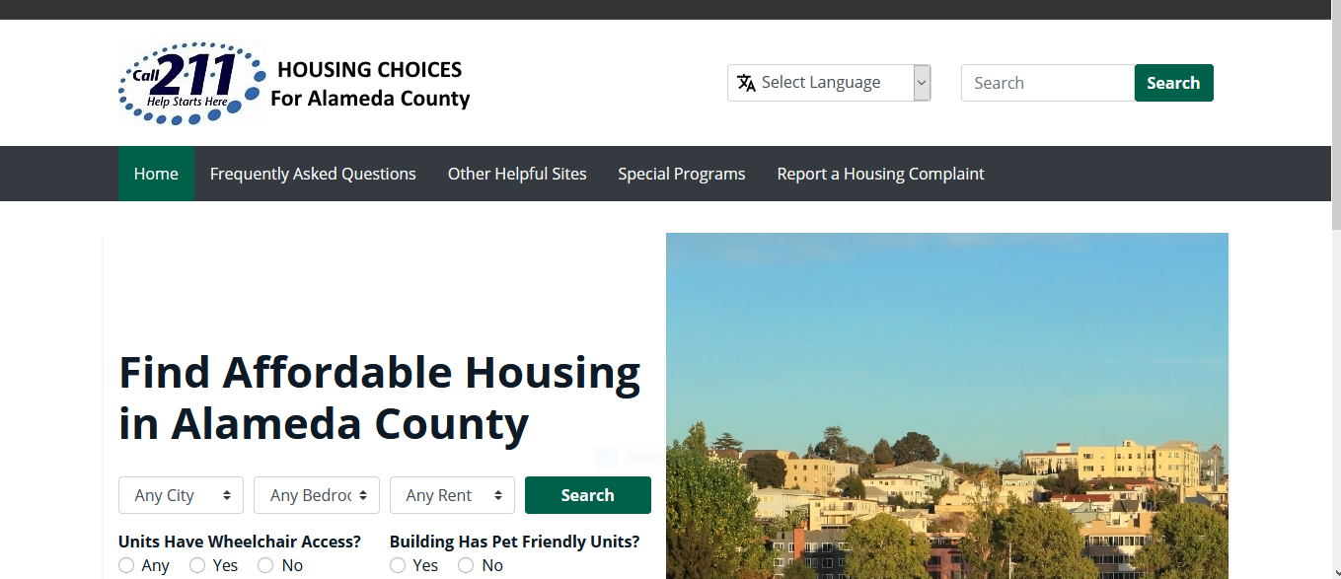
AC Housing Choices Website
URL – www.achousingchoices.org

Slide 17
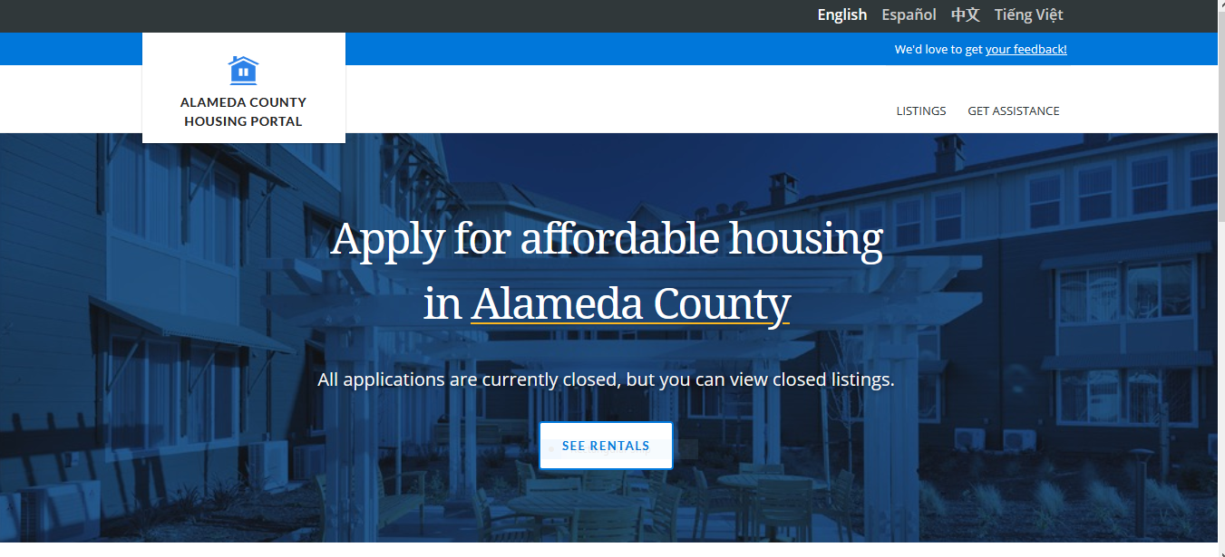
New Alameda County Affordable Housing Portal https://housing.acgov.org/

Slide 18
Let’s summarize
Use 211 Call Center and CHOICES website for your one-stop-shop.
Find Affordable Housing
Permanent
Find open waiting list on CHOICES website or call 211 and apply for as many as possible.
Short term
Room and Board – website https://ilacalifornia.org/alameda-county/ or Google - ILA Alameda County
Shares and beds – call 211.
Transitional Housing - call 211
If you are homeless register for CES -call 211

Slide 19
Let’s Summarize cont…
Locations, Needs and Eligibility
City – Be as flexible as possible.
Special Needs – select wheelchair unit on CHOICES website or call 211.
Age - Many 62+ age developments, CHOICES and call 211.
Citizenship status – Non-citizens can apply for Tax Credit Affordable Housing using TIN numbers, CHOICES and Call 211
Criminal Background/Credit –. Always appeal if you are denied. Get character reference letters. Work on expunging your background record, use the Clean Slate clinic and Call 211 for referral.

Slide 20
Let’s Summarize, cont…
Apply
Apply only during open waiting period.
It is free to apply
Acquire an application at site, online or ask the manager to mail one.
211 does not have applications nor tracks applications.
Complete application carefully and truthfully
Submit it to manager as instructed.
Keep a Master List of where you applied, with dates and best contact.
Stable Mailing address or have a PO Box. Check mail regularly.
Get Your Finances and Credit Ready
Free credit repair at Spark Point, call 211 for this referral.
Have your IDs and income verifications ready and current.

Slide 21
BIGGEST TIPS!
Master List
Solid Mailing address
Check mail regularly
Your contact info updated
Clean up credit and background
Use 211 and www.achousingchoices.org

Slide 22
211 Caller Feedback
Ms. G., called 211 starting in 2019. She received many affordable housing listings and applied all over the Bay Area. Today she has been approved for a unit in Walnut Creek and she has some advice to fellow seekers.
“Apply to many properties and keep a master list. Don’t believe people if they say the list is very long. I got calls from some places much faster than I expected. While you are waiting check your credit and clean it up as much as possible. Have all your documents and ID ready and current so when they call you are ready. Call the properties often and just ask if they have anything available. Don’t be discouraged, increase your motivation. Stay happy and positive.
I highly recommend 211 for affordable housing listings and other resources, like financial assistance and deposit assistance. I learned a lot by calling 211. The staff is very excellent, encouraging, welcoming and professional. It took two years for me to secure an affordable housing unit and I wanted to call and thank 211 for all their help. “

Slide 23
Contact Us
For questions call us (510) 727-9565
For housing listings call 211 or go to www.achousingchoices.org
E-mail us at housinginfo@edenir.org or pamg@edenir.org to receive this powerpoint.

Slide 24
QUESTIONS ?

Slide 25
Thank you for joining us today!

Slide 26
HOW TO LIST A PROPERTY WITH 2-1-1
Fill out the form on our website
Call us at
(510) 727-9565
www.achousingchoices.org. Scroll to the bottom and click on “List Your Property”
Agency Website
www.edenir.org
E-mail us at
housinginfo@edenir.org
Notes:
Ways to list your property with 2-1-1. Use our website and

Slide 27
Landlord Testimonials
“I’m appreciative of all the resources that I have learned to help me with my business of being a landlord and property owner. I also appreciate the phone calls from Almira, checking in and sharing information too.”
AM
Landlord, Mel Burton’s Audio
Notes:
Testimonials

Slide 28
Services for Landlords
Some examples
Mediation services
Legal services
Housing repair programs
2-1-1 lists services for landlords in Alameda County.
They often have income requirements since they are free or low-cost.
Notes:
On 2-1-1 our service database lists some services available to landlord who qualify by income level. I brought a few brochures explains a home repair grants for Alameda County.

Slide 29
Before 2-1-1…
I can’t pay
my rent
My child is
on drugs
I want to
kill myself
I need to find
childcare
I want to
volunteer
We can’t help with that
Please call
back when
we’re open
I’ll try to transfer you to an agency who can help
We only do senior daycare
Why did you call us?
I’m not sure who you can call.
I don’t know, please hold.
We don’t
serve your
county.
Notes:
Alameda County has many services which required a directory or road map to find. For example: I need childcare, I’m not sure who you can call, we don’t serve your county, We only do senior care, I’ll try and transfer you to an agency that can help you, I don’t know, please hold,
Why did you call us, We can’t help with that.

Slide 30
After Implementation of 2-1-1
I can’t pay
my rent
My child is
on drugs
I want to
kill myself
I need to find
childcare
I want to
volunteer
2-1-1, how may
I help you?
Yes, I can connect you with someone who can help…
Drug
Rehabilitation
Center
Rental
Assistance
Program
Child Care
Resource
And Referral
Suicide
Prevention
Hotline
Volunteer
Center
Notes:
2-1-1 is our county directory and road map to local services. Providing hours of operation, eligibility, area served, bus stops near by and how to apply. It also has housing vacancies that accept programs or are affordable. This makes it possible to find resources.

Slide 31
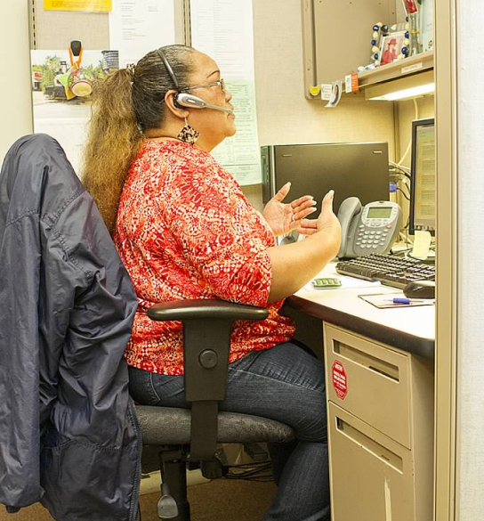
Since 2007, 2-1-1 Alameda County has handled nearly 1 million calls and provided over 1.6 million health, housing, and human service referrals.
Notes:
2-1-1 has received nearly 1 million calls since 2007. Providing 1.6 million health, housing and service referrals to callers

Slide 32
Get Applicants How does 2-1-1 serve landlords? 2-1-1 can refer callers to your vacancies.
Do 2-1-1 callers have vouchers or programs?
Yes, many of our callers have vouchers or programs
Notes:
Got applicants? How can 2-1-1 help you, the landlord? 2-1-1 can provde yu with any realsn.

Slide 33
Application overload
If I accept a program like Section 8 how do I advertise without being flooded with applicants?
Notes:
A common concern among many landlords when they advertise Section 8 units is too many applications!

Slide 34
Get fewer but more qualified applicants through 2-1-1
By using 2-1-1 to list your property you will receive pre-screened applicants.
We do not do credit checks and callers are self-reporting their situations and we do not verify the information.
Notes:
By using 2-1-1 get fewer applicants more qualified applicants. We do not do credit checks and callers are self-reporting their situations and we do not verify the information.

Slide 35
Qualification screening 2-1-1 will list your property and provide referrals that meet some of your qualifications. For example: -Types of programs or vouchers -Pets/no pets - Evictions/No evictions We do not do credit checks -
Notes:
Remember 2-1-1 pre-screens the applicants for you on a few of your requirements. We do not do credit checks.

Slide 36
How 2-1-1 works
You provide 2-1-1 with your property details
We enter that information into the housing database
Once there is a vacancy the information is made available to the 2-1-1 call center
2-1-1 callers do a short intake
2-1-1 operators will provide your contact information for those who match your qualifications.
Notes:
Here’s how it works. We enter your property information into the database. Once a call comes into 2-1-1 the operator will ask a series of question. This provides 2-1-1 operators with enough information to make qualified referrals to landlords by providing contact information. If you wish to gain more exposure you can also list your property on our website which has over 5,000 user a month.

